Slide 1



VLSI IMPLEMENTATION OF TURBO CODE FOR LTE USING VERILOG HDL
DEPARTMENT OF ELECTRONICS AND COMMUNICATION ENGINEERING
18ECP104L-MINOR PROJECT II
FINAL REVIEW
Presented By:
R.Priyadharshini (927621BEC154)
Guided by:
Mr. K. Kaarthik,
AP/ ECE,

Slide 2
OBJECTIVES
The main objective of this project is
To Implement Turbo encoder and decoder.
To correct the errors and retrieve the original message .
To reduce the number of iterations required to decode the information bits being transmitted.

Slide 3
ABSTRACT
Turbo codes are error correction codes that are widely used in communication systems. Turbo codes exhibits high error correction capability as compared with other error correction codes.
This paper proposes a Very Large Scale Integration (VLSI) architecture for the implementation of Turbo decoder. Soft-in-soft out decoders, interleaver and Deinterleaver is used in the decoder side which employs Maximum-a-Posteriori (MAP) algorithm.
The number of iterations required to decode the information bits being transmitted is reduced by the use of MAP algorithm. For the encoder part, this paper uses a system which contains two Recursive convolutional encoders along with pseudorandom interleaver in encoder side.

Slide 4
INTRODUCTION
Turbo coding is a very effective technique for correcting errors, which in recent years had a huge effect on channel coding.
Turbo coding in digital communication is one of the most common and successful coding techniques for enhancing the bit error rate.
Turbo encoder is to be an integrated module in the In-Vehicle Device embedded module by using the magnitude comparator.
The encoding of these symbols in a form that is suitable for transmission over a physical medium of interest.
The transmission of the encoded symbols to the desired destination.
The decoding and reproduction of the original symbols.

Slide 5
TURBO ENCODER
Turbo encoder produces an encoded output which is an input to turbo decoder.
A turbo code is formed from the parallel concatenation of two codes separated by an interleaver.
Encoders are recursive systematic convolutional codes(RSC).
The interleaver reads the bits in a psuedo-random order.
The fundamental turbo code encoder is built using two recursive systematic convolutional (RSC) codes with parallel concatenation.
LTE employs a 1/3 rate parallel concatenated turbo code.

Slide 6
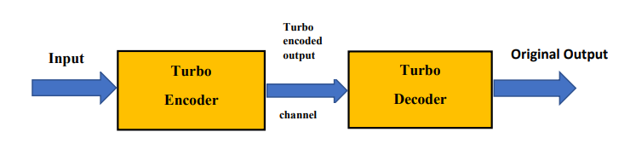
BASIC BLOCK DIAGRAM OF TURBO ENCODER

Slide 7
SOFTWARE REQUIREMENTS
Tool : Xilinx ISE 14.7
Xilinx ISE (Integrated Synthesis Environment) is a discontinued software tool from Xilinx for synthesis and analysis of HDL designs, which primarily targets development of embedded firmware for Xilinx FPGA and CPLD integrated circuit (IC) product families. It was succeeded by Xilinx Vivado.
HDL : Verilog

Slide 8
HARDWARE REQUIREMENTS
Computer (Operating System: Windows 10)
Xilinx ISE /coding software
Xilinx ISE 14.7 Version
Disk Space: 30 to 40 GB of available disk space with additional of 6 GB during installation.
RAM: 2 GB or higher.

Slide 9
IMPLEMENTATION
In a communication system, when data is transferred from the source system to a destination system, errors can be present in the received signal at the source end.
So error correction is required to retrieve the original message. Turbo codes, which were first introduced in 1993, represent a quantum leap in channel coding techniques and a turning point for modern digital telecommunication.
Turbo codes is one of existing powerful error correcting codes.
Turbo codes has inspired the coding community with the possibility of using an iterative decoding technique that relies solely on simple constituent code to achieve close channel capacity.
Turbo coder architecture comprises of turbo encoder and turbo decoder.

Slide 10
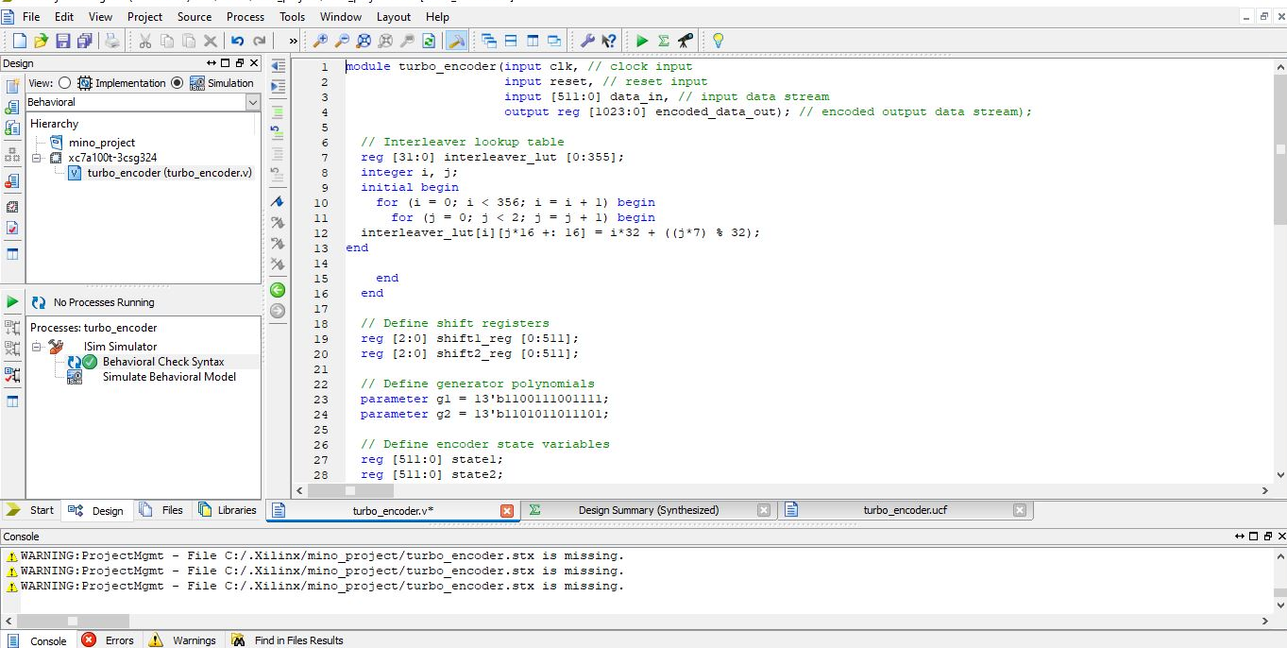
IMPLEMENTATION OF TURBO CODER

Slide 11
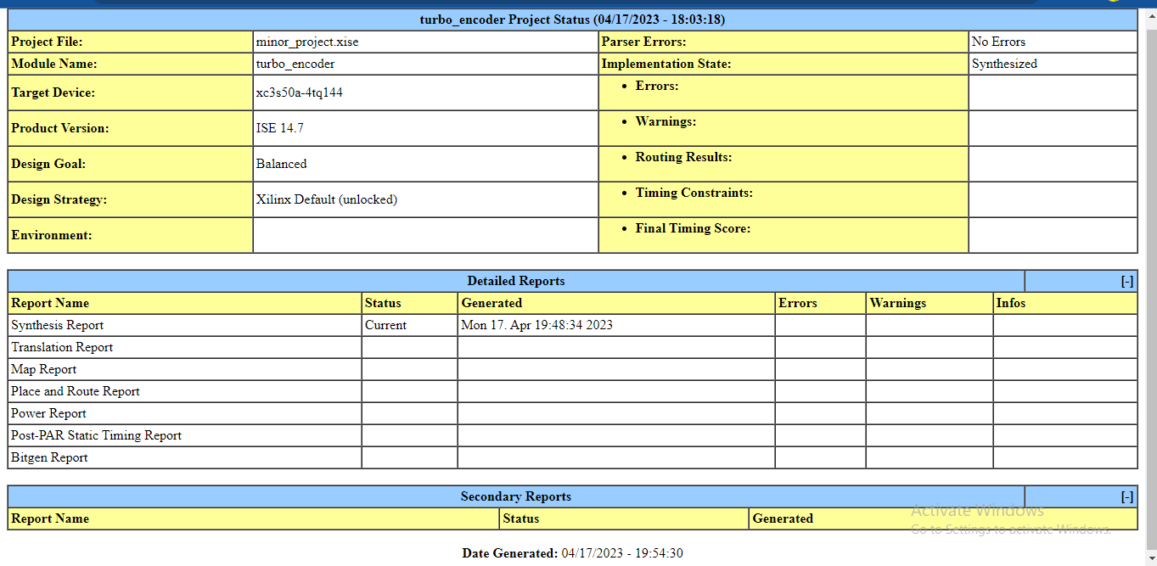
DESIGN SUMMARY

Slide 12
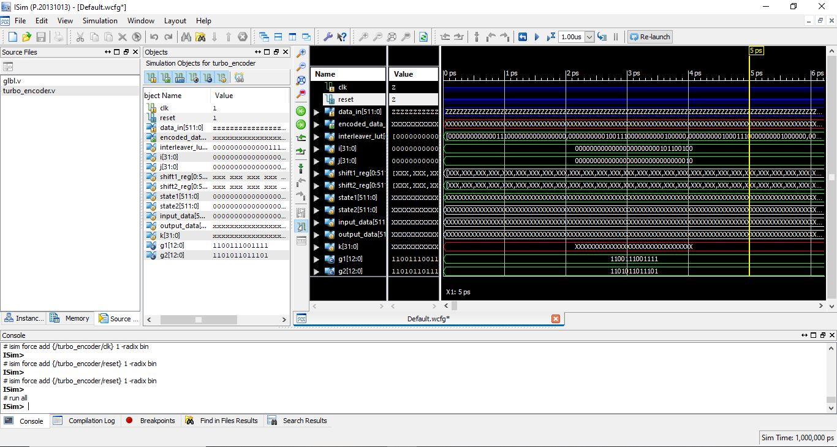
SIMULATION OUTPUT

Slide 13
ADVANTAGES OF VLSI IMPLEMENTATION
VLSI implementation of turbo codes for LTE using Verilog HDL offers many advantages over traditional design techniques.
It allows for faster design iterations, easier debugging, and improved performance.
It also enables the use of advanced design techniques, such as high-level synthesis, which can significantly reduce the development time of a system.
Additionally, Verilog HDL is a powerful language that can be used to quickly and easily create complex digital designs.

Slide 14
APPLICATIONS OF TURBO CODES
Wireless multimedia
Data: use large frame sizes - Low BER, but long latency.
Voice: use small frame sizes - Short latency, but higher BER.
Combined equalization and error correction decoding.
Combined multiuser detection and error correction decoding.

Slide 15
CONCLUSION
Turbo encoder and turbo decoder are components of the turbo coder architecture.
In this Project we designed Turbo Encoder. Two Recursive Convolutional Encoders (RSC) and an interleaver make up the encoder.
The Turbo encoder is simulated in Verilog HDL using Xilinx ISE 14.7 version.
Input information bits are given to Turbo encoder that encodes data and then transmitted to Turbo Decoder through channel to obtain 24-bit output data.
At decoder, the received data may contain errors, which are decoded using SOVA algorithm to obtain original information.

Slide 16
REFERENCES
1. V.Kavinilavu1,S.Salivahanan,V.S.KanchanaBhaaskaran2,Samiappa Sakthikumaran, B.Brindha and C.Vinoth “Implementation of Convolutional Encoder and Viterbi Decoder using Verilog HDL”, IEEE 3rd International Conference on Electronics Computer Technology,2011.
2. Tepoju Vivek Vardhan, Bandi Neeraja, Boya Pradeep Kumar, Chandra Sekhar Paidimarry “Implementation of Turbo Codes Using Verilog HDL and Estimation of Its Error Correction Capability”, IEEE Asia Pacific Conference on Postgraduate Research in Microelectronics and Electronics (PrimeAsia),2015.
3. Claude Berrou, Ramesh Pyndiah, Patrick Adde, Catherine Douillard and Raphaël Bidan, “Application of turbo codes”, IEEE 2005.
Aswathy Narayanan; Senthil Murugan; Ramesh Bhakthavatchalu, “Low Latency Max Log MAP based Turbo Decoder”, International Conference on Communication and Signal Processing(ICCSP),2019.

Slide 17


